Slide 1


The Java Legacy Code Survival Guide
Add Features Without Fear
Steven Diamante July 16, 2025
Notes:
I love legacy code!
A lot of developers don’t
I’ve always enjoyed improving code design and adding automated tests
XP start
TDD talk — How do we apply TDD to legacy code?
Follow up talk on Legacy Code
Working Effectively with Legacy Code
Diamante Investments
I’ve broken things refactoring. I’ve made changes that made the code cleaner but the system worse.
I’ve also learned from those mistakes. I’ve come into new codebases—deleted tons of dead code and created domain models and better abstractions so even the product owner could understand what the code is doing.
This talk is about overcoming the fear of legacy code by learning the tools & techniques
that software menders use to work effectively with legacy code.

Slide 2

Why does changing legacy code feel risky?
Legacy Code is profitable software that I’m afraid to change
no tests
hidden side effects
logic and I/O mixed together
changing one thing, breaks another
Notes:
There’s many different definitions of Legacy Code.
code without tests
code that’s been inherited, etc.
it’s in the eye of the beholder—It’s a feeling (subjective)
Legacy Code is valuable software that I’m afraid to change
it’s all about perspective. One person’s prison is another’s playground (makers vs. menders)

Slide 3
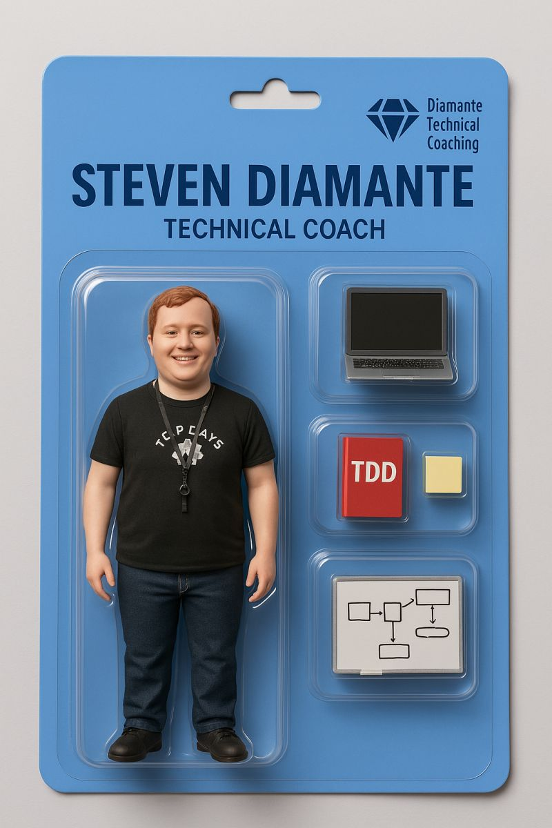

The Quest
Who am I?
Lives in Raleigh, NC
Software Craftsman
Building AI solutions at Artium AI
Working on Enterprise Java Microservices for 7 years
Musician & Meditator
Notes:
I’ve refactored a lot of it along the way, I’ve failed and learned from it as well
I’ve taught others to do the same
I coach developers on technical practices like social programming, TDD, refactoring, and legacy code coping mechanisms

Slide 4

Surviving Legacy Code Takes More Than Courage
Legacy Code = 🐉
It’ll burn you if you charge in blind
Most would rather run than fight it
You need the right gear
🛡️ Shield = Characterization Tests
🗡️ Sword = Refactoring
🔥 Torch = Logs & Observability
👥 Scout = Social Programming
Notes:
It’ll burn you if you charge in blind
You need a gameplan
Most would rather run than fight it
Legacy code has this inherit healthy amount of fear
You need the right gear
You wouldn’t fight a dragon with your bare hands
Tools can help us to tackle legacy code more effectively

Slide 5
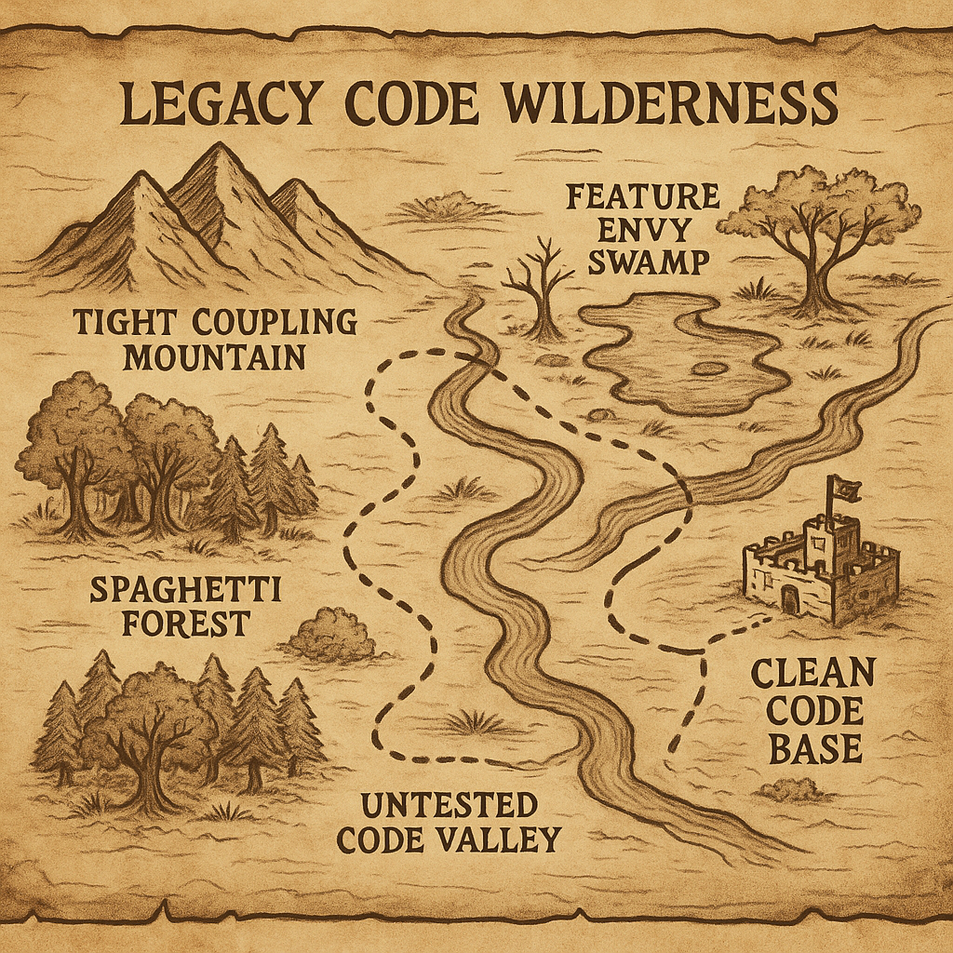
The Legacy Code Quest
🕵️ Step 1: Explore the Code
⚔️ Step 2: Break Dependencies
🛡️ Step 3: Build Safety Nets
🔄 Step 4: Refactor Carefully
🏰 Step 5: Add New Feature With Confidence
Notes:
🕵️ Step 1: Explore the Code
Understand what you’re dealing with. Find the monsters (pain points). Map the terrain (dependencies).
⚔️ Step 2: Break Dependencies
Break tight coupling. Separate logic from I/O so you can fight the real enemy (business logic) safely.
🛡️ Step 3: Build Safety Nets
Add tests or guardrails before you make any changes. Know when you break something.
🔄 Step 4: Refactor Carefully
Clean up the code step by step without risking the castle. Make it easier to add new features later.
🏰 Step 5: Add Your Feature With Confidence
Now that the path is clear and safe, add what the business needs without fear.
This talk is your guide. I’ll walk you through a practical example—a loan approval service—and show you how I navigate real messy Java code step by step. No theory. No silver bullets. Just tools you can use tomorrow.

Slide 6
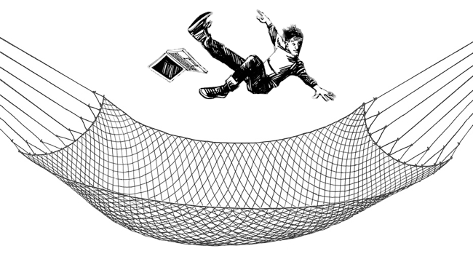
What makes change safe?
Structural vs. Behavioral
Great tools & tests
Notes:
What makes change safe?
We want to understand what the code is doing.
We want to understand the dependencies and coupling it has with nearby systems.
What kind of change?
Structural
Behavioral
High quality automated testing tell us that when the structure of the code is changed the tests pass, but if the behavior is altered the tests fail
Refactoring means improve design.
Change the structure of the code without changing its observable behavior
Refactoring should never break the tests. It’s all about small safe steps.
Failing at refactoring can lead to losing trust, and that it's important to practice and develop good habits around improving design safely.

Slide 7
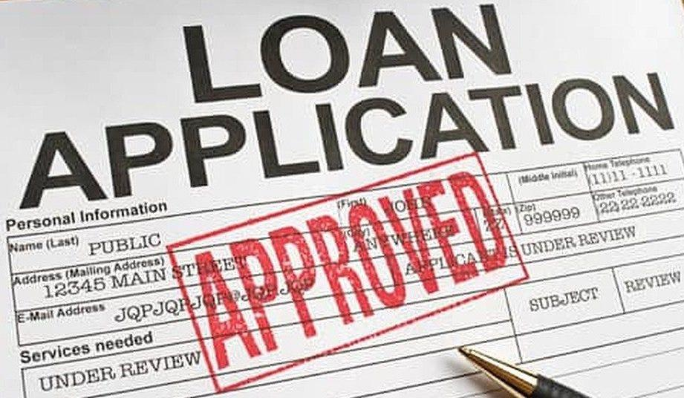
New Requirement
Flag certain applications for Manual Review
🔎
✅ ❌
Notes:
Explain app
New requirement: Add Needs manual review status.
Run the application and show the approved state.

Slide 8
🕵️ Step 1: Explore the Code
Notes:
Understand what you’re dealing with. Find the monsters (pain points). Map the terrain (dependencies).
Look at LoanApplicationService.java
Identify potential pain points to testing
Identify seams
Show feature for Needs Manual Review application status
Attempt to write the test and describe the problems associated with testing this code

Slide 9

⚔️ Step 2: Break Dependencies
Subclass and override
Peel
Peel and slice
Dependency injection
Notes:
Dependency Breaking Techniques: Legacy Code Paradox
Show Peel and Peel & Slice
Credit Score API & Postgres DB running in Docker
Peel -> API
docker stop loan-management
Peel and Slice -> Repo

Slide 10
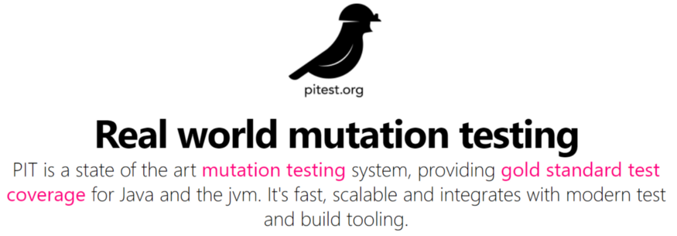

🛡️ Step 3: Build Safety Nets
Notes:
Add tests before making any changes. Know when you break something.
Approvals are great at quickly adding tests for large chunks of code.
Easy to assert a large output.
Great for legacy code!
Unit tests are more of a time investment
most times end up getting rewritten
after the refactoring since the tests are difficult to write from a behavior standpoint with the code tangled
Mutation testing can be used to test the quality of the approval tests.
rejectedLoans test (rejectedLoans)
Run test coverage
approvedLoans test (approvedLoans)
verifyAll (allRejectedLoans)
Test coverage
Remove @SpringBootTest
Mutation tests (build/reports/pitest/index.html)
Tell Mapping bug story — $0 cashback for specific credit cards
I discard Approvals once they have served their function

Slide 11
🔄 Step 4: Refactor Carefully
Goal: Split up I/O and business logic so methods are pure and trivial to test
Refactoring System
🍊Low Hanging Fruit
🏷️ Improve names
♻️ Spot and remove duplication
📦 Extract code paragraphs
🧩 Find hidden Value Objects and Services in the class and pull them out

Slide 12

🔄 Step 4: Refactor Carefully
Refactoring System
🍊Low Hanging Fruit
— remove clutter
— resolve linting errors
— reformat file
Notes:
Continuous test runner — ./gradlew test -t

Slide 13
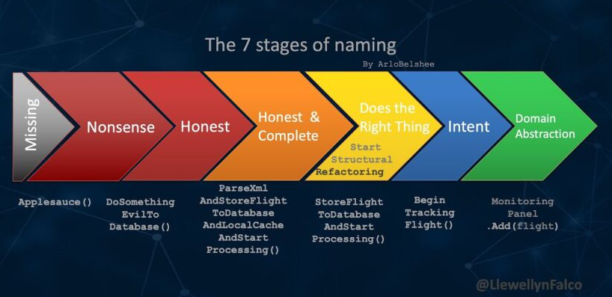
🔄 Step 4: Refactor Carefully
Refactoring System
2. 🏷️ Improve names
— scan top to bottom
— Naming as a Process
Notes:
Rename income, debt
Be careful of renaming DTOs.

Slide 14

🔄 Step 4: Refactor Carefully
Refactoring System
3. ♻️ Spot and remove duplication
— be pragmatic
Notes:
Inline variables
Spot duplication

Slide 15

🔄 Step 4: Refactor Carefully
Refactoring System
4. 📦 Extract code paragraphs
— comments are helpful hints
common paragraphs:
if-else blocks
loops
try-catch
Notes:
Skip this part since this this code example doesn’t have code paragraphs worth extracting

Slide 16

🔄 Step 4: Refactor Carefully
Refactoring System
5. 🧩 Find hidden Value Objects and Services in the class and pull them out
— introduce domain model
— helps to separate business logic from I/O
— the domain starts to live in the code
Notes:
Map request to domain (LoanApplication)
Map domain to entity
Map domain to response
Move determineLoanStatus
Extract LoanStatus enum
Extract Value Objects, CreditScore, DebtToIncomeRatio, & LoanToIncomeRatio. Add unit tests
(only do creditScore, invalidCreditScore and fast-forward the others)
LoanApplicationServiceTest -> unit tests only look at status

Slide 17
🏰 Step 5: Add New Feature With Confidence

Slide 18
New Requirement
Flag certain applications for Manual Review
🔎
✅ ❌

Slide 19
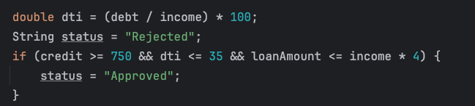
Common code smells
Feature Envy / Primitive Obsession
Magic Strings/Numbers
Bad Names
Long methods

Slide 20

What about GenAI?
Great collaborator
Coding agents not ready for Legacy
Devs still need design knowledge
LLMs could create more legacy code
Notes:
Great collaborator
Explaining codebases
Creating architectural diagrams of current systems
Suggesting refactoring approaches
Coding agents not ready for Legacy
Of course, this could change but I think asking AI for suggestions on refactoring is a great use case.
But automated refactoring tools are safer and cheaper to pull off those refactorings.
When LLMs improve…bullet-proof testing will be essential
Devs still need design knowledge
We need to have a shared vocabulary with the LLM. Code smells and refactoring already exist for that. Learning these will be vital.
We still face the design stamina hypothesis in a world of coding agents
LLMs could create more legacy code
If AI wrote the code and you don’t understand it and you ship it to prod, isn’t that legacy code?
I wouldn’t add tests using LLMs
Need to be able to trust tests
Missed opportunity for Theory building
The tests it produces are not readable specs I do add tests with LLMs after refactoring to a clean test fixture that is easy to understand and build on top of.
This helps the LLM be more consistent.

Slide 21
Key Takeaways
Cover and Modify
“Best” practices rarely apply in Legacy Code Rescue
Micro commits
Requires practice in safe environments
Notes:
Cover and Modify
Mutation testing + Approvals
“Best” practices rarely apply in Legacy Code Rescue
Need to cut corners and do some not so great things in order to test and improve the code
Micro commits
Enables safe rollbacks
Checkpoints for refactoring
Requires practice in safe environments
Learning Hours! Katas! Coding dojos! Legacy Code Retreats!

Slide 22

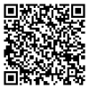


Legacy code won’t fix itself
Heroes will!
@SDiamante
linkedin.com/in/stevendiamante
diamantetechcoaching.com
Notes:
Be brave, bring some friends, and equip yourself with good tools and everything will be fine!
I offer technical coaching services for individuals and teams so if you need some help, let’s connect and see how I can help

